Slide 1
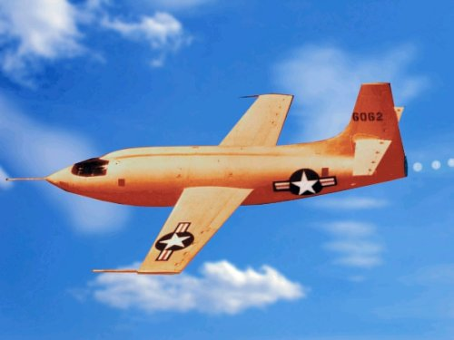

Slide 2
OPER 610 Lesson 01 Administration, Introduction to LP, Modeling, and Key Definitions
Dr Brian J. Lunday
Office: Rm 201E, Bldg 641

Slide 3
Administration
Syllabus
Homework policy
Exams
Authorized references for the course
Textbook
Notes & lesson-specific presentations
Classmates (with limitations)
Old homework
Old exams
Use of Canvas LMS
Office Hours

Slide 4
Why is OPER 610 a core course?
Operations Research Discipline
(Core courses)
Analyst Skills
(Required courses)
PREREQUISITE MATH
OPTIMIZATION
MATH 521
FOR 15A/FA49 ASSIGNMENT UTILITY
OPER 510
OPER 610
It’s core to the OR discipline.
Its solution methods underpin optimization techniques for IPs, convex NLPs, nonconvex NLPs, etc.
It supports many ENS theses.
OPER 544
OPER 695
STAT 587
OPER 640
OPER 679
OPER 685
OPER 561
SIMULATION
PROBABILITY
& STATISTICS
OTHER O.R. FIELDS
OPER 631
Notes:
What’s the difference between 510 & 610?
Breadth vs. Depth
Modeling and a basic solution method vs. a true understanding of solution methodologies
Why not just 510?
It’s an MS in Operations Research, and it’s core to the discipline.
Were in an MS in IE or SE, typically taking either one would be sufficient exposure to optimization.

Slide 5
OPER 610 Outcomes
Students will be able to:
Model problems using linear programming with algebraic (i.e., set-based and indexed) notation for a variety of applications in industry and the military.
Understand and explain both the conceptual geometry and the procedural linear algebra of an exterior point algorithm, how they relate to each other, and how they relate to the Karush-Kuhn-Tucker optimality conditions.
Develop dual formulations to linear programs and explain the relevance of duality to both (a) sensitivity analysis and (b) selected mathematical programming solution methods.
Attain a conceptual understanding of both exterior and interior point algorithmic design that will enable future studies in optimization-related studies.
Develop functional literacy with algebraic modeling languages (AMLs) to invoke commercial optimization software for math programming.

Slide 6
Modeling and Analysis of LPs
Problem Formulation
Objectives
Restrictions, Limitations, and Constraints
Within DoD planning, it’s “limitations = constraints + restrictions”
Model Creation
Formulate the math program
Granularity vs. tractability
Assumptions and more assumptions!
Algebraic formulation
Sets, parameters, decision variables
Objective function(s), constraints, decision variable bounds
Verification, Validation, & Refinement (VV&R)
Testing, Analysis, Restructuring
Iterative implementation
Granularity vs. tractability
Robustness to parametric variations
Implement the Solution
Prescriptive analytics vs. “Recommendive” analytics
If the problem isn’t static, will the solution be?
Solve the MP Instance
Problem vs. math program vs. instance
What does a “solution” entail?
Algorithm vs. heuristic vs. metaheuristic

Slide 7
Key Terms
Objective function
Cost coefficients
Decision variables
Constraints
Constraint matrix
Technological coefficients
Right-hand-side vector
Non-negativity constraints
Feasible region & feasible point(s)

Slide 8




Alternative Representations
With which of these representations are you most comfortable?
$$\begin{matrix}min & c^{t}x \\ s.t. & Ax=b \\ & x≥0\end{matrix}$$
$$\begin{matrix}min & \sum_{j=1}^{n}{c_{j}x_{j}} & \\ s.t. & a^{i}x=b_{i}, & i=1,…,m \\ & x_{j}≥0, & j=1,…,n.\end{matrix}$$
How and why is this one different from the textbook?
$$\begin{matrix}min & \sum_{j=1}^{n}{c_{j}x_{j}} & \\ s.t. & \sum_{j=1}^{n}{a_{j}x_{j}}=b & \\ & x_{j}≥0, & j=1,…,n.\end{matrix}$$
$$\begin{matrix}min & \sum_{j=1}^{n}{c_{j}x_{j}} & \\ s.t. & \sum_{j=1}^{n}{a_{ij}x_{j}}=b_{i}, & i=1,…,m \\ & x_{j}≥0, & j=1,…,n.\end{matrix}$$

Slide 9
Assumptions
Proportionality
Additivity
Divisibility
Deterministic
Notes:
Proportionality – linear contribution of x_j to obj, consts., etc. What’s an example in life when it doesn’t hold? (OPER 612)
Additivity – no subadditivity or supperadditivity. Counterexample? (Could be OPER 610… or OPER 612)
Divisibility – decimal-valued DVs. Counterexample? (OPER 613)
Deterministic – counterexample? How to handle it? (OPER 615)
* Dantzig anecdote from pg 4!!!

Slide 10
Problem Manipulations
Inequalities & equations
Non-negativity of variables
Minimization & maximization problems
Notes:
Transformations…

Slide 11
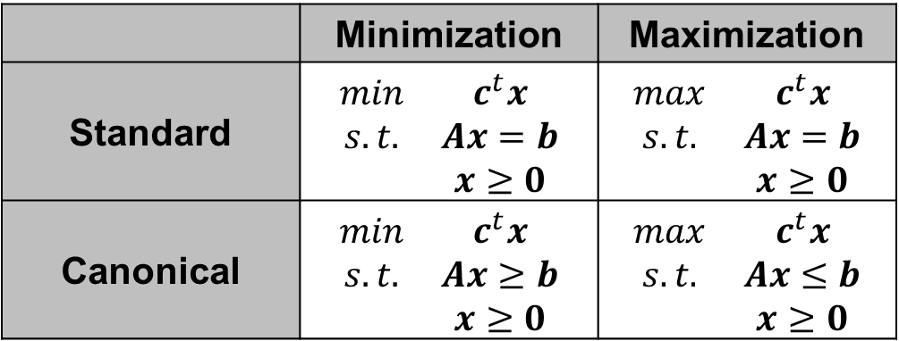
Funadamental LP Formats
 | Minimization | Maximization
Standard | $$\begin{matrix}min & c^{t}x \\ s.t. & Ax=b \\ & x≥0\end{matrix}$$ | $$\begin{matrix}max & c^{t}x \\ s.t. & Ax=b \\ & x≥0\end{matrix}$$
Canonical | $$\begin{matrix}min & c^{t}x \\ s.t. & Ax≥b \\ & x≥0\end{matrix}$$ | $$\begin{matrix}max & c^{t}x \\ s.t. & Ax≤b \\ & x≥0\end{matrix}$$

Slide 12
Common Software for LP
Algebraic Modeling Languages (AMLs)
GAMS
LINGO IDE
IBM’s Optimization Programming Language (OPL)
AMPL
MPS
Generalized Programming Languages (GPLs)
C++
Java
.NET
Python
MATLAB
Problem Formulation
Objectives
Restrictions, Limitations, and Constraints
Within DoD planning, it’s “limitations = constraints + restrictions”
Model Creation
Formulate the math program
Granularity vs. tractability
Assumptions and more assumptions!
Algebraic formulation
Sets, parameters, decision variables
Objective function(s), constraints, decision variable bounds
Verification, Validation, & Refinement (VV&R)
Model & solve packages
(typically more limiting)
Excel (Solver)
Julia (JuliaOpt)
Mathematica (Minimize)
MATLAB (linprog)
Python (Pyomo, others)
R (lpSolve)
SAS (LPSOLVE)
Testing, Analysis, Restructuring
Iterative implementation
Granularity vs. tractability
Robustness to parametric variations
Commercial Solvers
BDMLP
CLP
CPLEX
FICO-Xpress
Gurobi
MOSEK
And many more…
Implement the Solution
Prescriptive analytics vs. “Recommendive” analytics
If the problem isn’t static, will the solution be?
Solve the MP Instance
Problem vs. math program vs. instance
What does a “solution” entail?
Algorithm vs. heuristic vs. metaheuristic

Slide 13
Formulations from Today’s Readings
Feed Mix Problem
Production Scheduling: An Optimal Control problem
Cutting Stock Problem
Transportation Problem
Capital Budgeting Problem
Tanker Scheduling Problem
Multiperiod Coal Blending and Distribution Problem

Slide 14
Example Problem 1.1 (1 of 5)
Fred has $5000 to invest over the next five years.
At the beginning of each year he can invest money in one- or two-year time deposits.
The bank pays 4% interest on one-year time deposits and 9% (total) on two-year time deposits.
In addition, West World Limited will offer three-year certificates starting at the beginning of the second year. These certificates will return 15% (total).
If Fred reinvests his money that is available every year, formulate a linear program to show him how to maximize his total cash on hand at the end of the fifth year.

Slide 15







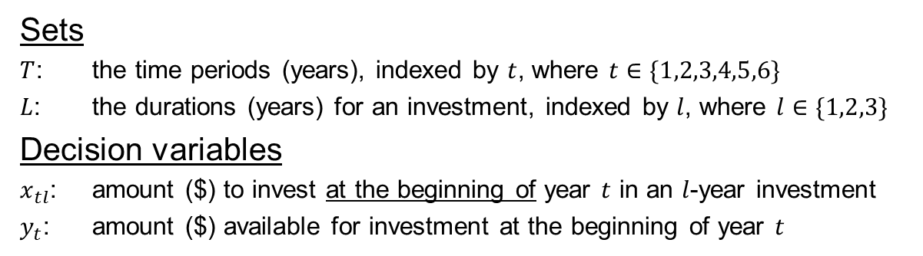










Example Problem 1.1 (2 of 5)
Sets
$T$: the time periods (years), indexed by $t$, where $t∈\{1,2,3,4,5,6\}$
$L$: the durations (years) for an investment, indexed by $l$, where $l∈\{1,2,3\}$
Decision variables
$x_{tl}$: amount ($) to invest at the beginning of year $t$ in an $l$-year investment
$y_{t}$: amount ($) available for investment at the beginning of year $t$
Note: This may differ from the model we construct in class, but it is also valid.
$$y_{1}$$
1
$$x_{11}$$
$$y_{2}$$
2
$$x_{21}$$
$$y_{3}$$
$$x_{12}$$
$$x_{23}$$
3
$$x_{31}$$
$$y_{4}$$
$$x_{22}$$
4
$$x_{33}$$
$$x_{41}$$
$$y_{5}$$
$$x_{32}$$
5
$$x_{51}$$
$$y_{6}$$
$$x_{42}$$
6

Slide 16
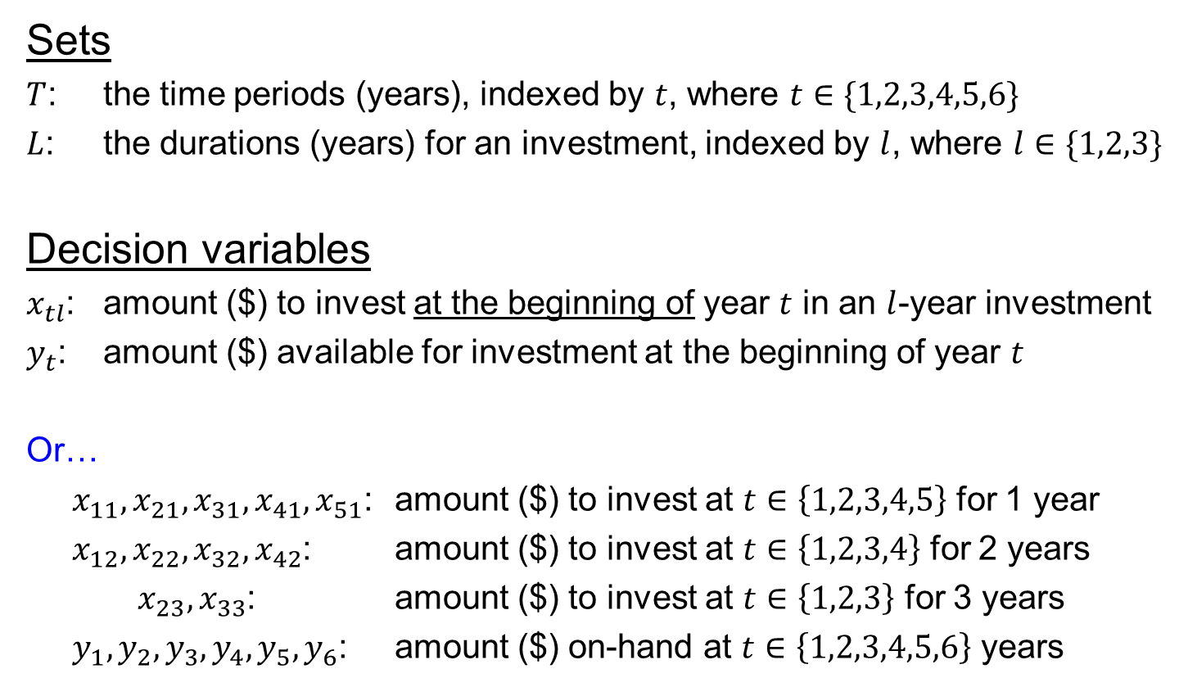
Example Problem 1.1 (3 of 5) – w/o the diagram
Sets
$T$: the time periods (years), indexed by $t$, where $t∈\{1,2,3,4,5,6\}$
$L$: the durations (years) for an investment, indexed by $l$, where $l∈\{1,2,3\}$
Decision variables
$x_{tl}$: amount ($) to invest at the beginning of year $t$ in an $l$-year investment
$y_{t}$: amount ($) available for investment at the beginning of year $t$
Or…
$x_{11},x_{21},x_{31},x_{41},x_{51}$: amount ($) to invest at $t∈\left\{1,2,3,4,5\right\}$ for 1 year
$x_{12},x_{22},x_{32},x_{42}$: amount ($) to invest at $t∈\left\{1,2,3,4\right\}$ for 2 years
$x_{23},x_{33}$: amount ($) to invest at $t∈\left\{1,2,3\right\}$ for 3 years
$y_{1},y_{2},y_{3},y_{4},y_{5},y_{6}$: amount ($) on-hand at $t∈\left\{1,2,3,4,5,6\right\}$ years
Note: This may differ from the model we construct in class, but it is also valid.

Slide 17

Example Problem 1.1 (4 of 5)
Explicit Formulation
$$\begin{matrix}max & y_{6} \\ s.t. & y_{1}=5000 \\ & x_{11}+x_{12}≤y_{1} \\ & y_{2}=y_{1}+0.04x_{11}−x_{12} \\ & x_{21}+x_{22}+x_{23}≤y_{2} \\ & y_{3}=y_{2}+0.04x_{21}−x_{22}−x_{23}+1.09x_{12} \\ & x_{31}+x_{32}+x_{33}≤y_{3} \\ & y_{4}=y_{3}+0.04x_{31}−x_{32}−x_{33}+1.09x_{22} \\ & x_{41}+x_{42}≤y_{4} \\ & y_{5}=y_{4}+0.04x_{41}−x_{42}+1.09x_{32}+1.15x_{23} \\ & x_{51}≤y_{5} \\ & y_{6}=y_{5}+0.04x_{51}+1.09x_{42}+1.15x_{33} \\ & x_{11},x_{12},x_{21},x_{22},x_{23},x_{31},x_{32},x_{33},x_{41},x_{42},x_{51}≥0 \\ & y_{1},y_{2},y_{3},y_{4},y_{5},y_{6},≥0\end{matrix}$$
Note: This may differ from the model we construct in class, but it is also valid.
Maximizes the cash on-hand in year 6
Calculates the cash on-hand in year 1
Limits the investments in year 1
Calculates cash on-hand in year 2
Limits the investments in year 2
Et cetera…
Enforces non-negativity of DVs
What assumptions did we make?
Why are there inequalities in selected constraints? How would the model differ if they were equalities?
How can we transform this to standard format? Canonical format? Should we?
Can we reduce the number of decision variables? Should we?

Slide 18
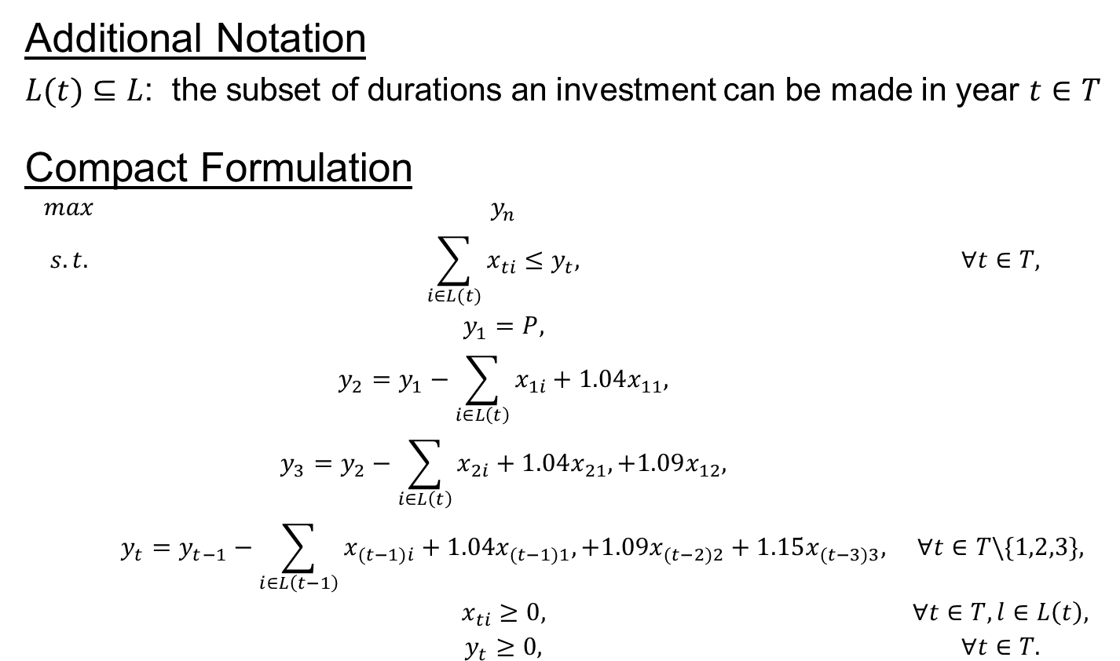
Example Problem 1.1 (5 of 5)
Additional Notation
$L(t)⊆L$: the subset of durations an investment can be made in year $t∈T$
Compact Formulation
$$\begin{matrix}max & y_{n} & \\ s.t. & \sum_{i∈L(t)}{x_{ti}}≤y_{t}, & ∀t∈T, \\ & y_{1}=P, & \\ & y_{2}=y_{1}−\sum_{i∈L\left(t\right)}{x_{1i}}+1.04x_{11}, & \\ & y_{3}=y_{2}−\sum_{i∈L\left(t\right)}{x_{2i}}+1.04x_{21},+1.09x_{12}, & \\ & y_{t}=y_{t−1}−\sum_{i∈L\left(t−1\right)}{x_{(t−1)i}}+1.04x_{(t−1)1},+1.09x_{(t−2)2}+1.15x_{(t−3)3}, & ∀t∈T\backslash \{1,2,3\}, \\ & x_{ti}≥0, & ∀t∈T,l∈L\left(t\right), \\ & y_{t}≥0, & ∀t∈T.\end{matrix}$$

Slide 19
Questions & Discussion

Slide 20
For Next Class
Sections 1.3-1.5
Homework #1: Problem 1.2 (Phase 1)
First, write an explicit formulation
Define sets, parameters, DVs, assumptions!
Second, use set-based notation and indexing of DVs and constraints to present a compact formulation

